Slide 1
Predicting Plant Water Requirements Using Soft Computing Techniques
BATCH NUMBER: AI-IPA-106
MEMBERS: 190030385

Slide 2
ABSTRACT

Slide 3
Predicting the amount of water that should be given to plants based on humidity and temperature is an important task for effective plant care. Soft computing techniques, which involve the use of computational methods that are designed to mimic the way the human brain processes information, can be used to develop predictive models for this purpose. One approach that has been shown to be effective is the use of artificial neural networks (ANNs). ANNs are computational models that are inspired by the structure and function of the human brain and are capable of learning and adapting based on experience. They can be trained using data on humidity and temperature levels, as well as information on the amount of water that was given to plants under different conditions. Other soft computing techniques that have been used for predicting water requirements for plants include fuzzy logic systems and genetic algorithms. Fuzzy logic systems are based on the idea that values can be "fuzzy" or imprecise, rather than being binary (either 0 or 1). This allows them to better capture the complex and often nonlinear relationships between humidity, temperature, and water needs. Genetic algorithms, on the other hand, are optimization techniques that use principles of natural selection and evolution to find the best solution to a problem. Overall, soft computing techniques offer a powerful toolkit for predicting the amount of water that should be given to plants based on humidity and temperature. They have the ability to handle complex and uncertain data, making them well-suited for this task

Slide 4
INTRODUCTION

Slide 5
Plants are living organisms that require a range of environmental conditions in order to thrive. One of the most important factors for plant health is water, as it is essential for photosynthesis, respiration, and the transport of nutrients throughout the plant. Ensuring that plants receive the right amount of water is therefore crucial for their growth and development.
Predicting the amount of water that should be given to plants is not always straightforward, however, as it depends on a range of factors such as humidity, temperature, and the type of plant being grown. Traditional approaches to predicting water requirements have often relied on rules of thumb or expert knowledge, which may not always be accurate or reliable.
In recent years, there has been increasing interest in using soft computing techniques to predict plant water requirements more accurately. Soft computing involves the use of computational methods that are designed to mimic the way the human brain processes information. These techniques include artificial neural networks, fuzzy logic systems, and genetic algorithms, among others. They have the ability to handle complex and uncertain data, making them well-suited for predicting water requirements in plants.

Slide 6
PROPOSED WORK

Slide 7
The fuzzy logic diagnostic system consists of a set of rules and an activation function. It was likewise skewed toward mathematical computations. It is a development tool that takes numerical output and turns them to fuzzification. This approach is applicable to issues with indeterminate and partial information, as well as when it is hard to ascertain this relevant data in reliable findings. There are three phases of fuzzy intelligent systems:
Fuzzification
Implication process
Defuzzification
In the fuzzification process, non fuzzy data are fed into an intelligent system, which transforms or converts them into fuzzy sets or fuzzy values. The expert system, as a fuzzy logic system, will map the instructions based on the provided input and, after triggering the appropriate rule, will create the output in fuzzy value. The output of the inference method is changed from imprecise to discrete values during defuzzification.

Slide 8
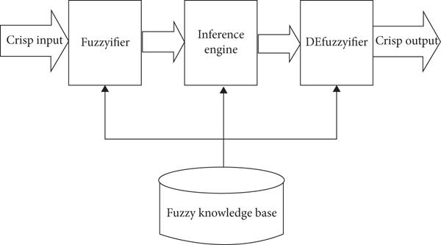

Slide 9
PROGRESS TILL NOW

Slide 10
There are 4 stages that we need to complete to fully build the fuzzy inference system or fuzzy logic system. They are:
Data Collection and Definition
Antecedent Definition
Consequent Definition
Fuzzification
Membership Function Definition
Scaling the Degree of Membership Function
Inference Engine
Rule Evaluation
Inference
Fuzzy Knowledge Base
Defuzzification

Slide 11
As of now, Stage 1 of the project is completed which is by collecting data which is required to judge how much time the water needs to supplied to the plants. And among many parameters I have decided to use 2 parameters to work on to judge on how much duration the water needs to be supplied. They are:
Temperature
Humidity
Since most of the areas in the world has the temperature being varied between -10 to 50. I have defined the data of temperature in that range.
As of the Humidity parameter they are broadly classified into 3 categories by the US National Oceanic and Atmospheric Administration. They are:
less than or equal to 55: dry and comfortable
between 55 and 65: becoming "sticky" with muggy evenings
greater than or equal to 65: lots of moisture in the air, becoming oppressive
So based on this study I have defined the data.This completes the section of Data Collection whereas the part of Definition it goes as below. That is
Antecedent Definition : Temperature and Humidity
Consequent Definition: Duration

Slide 12
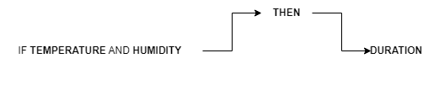
And the rule definition on which the Fuzzy Inference System works on is

Slide 13
THANK YOU

